Slide 1
Figure 2 data wrangling for Alibaba
文件创建于: 2021/9/5 3:08:57

Slide 2
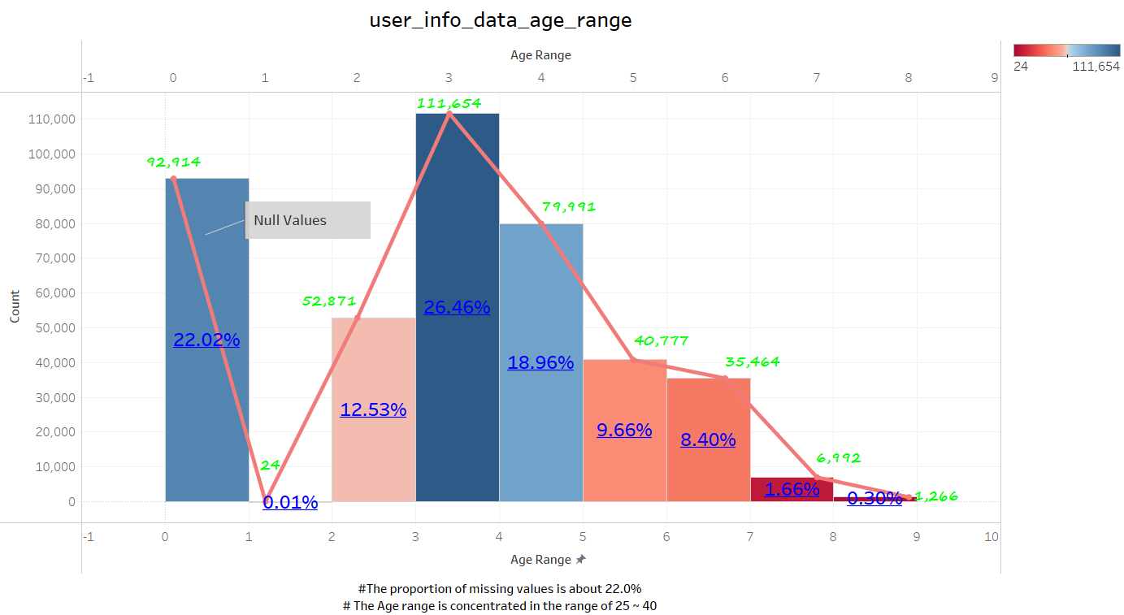

Slide 3
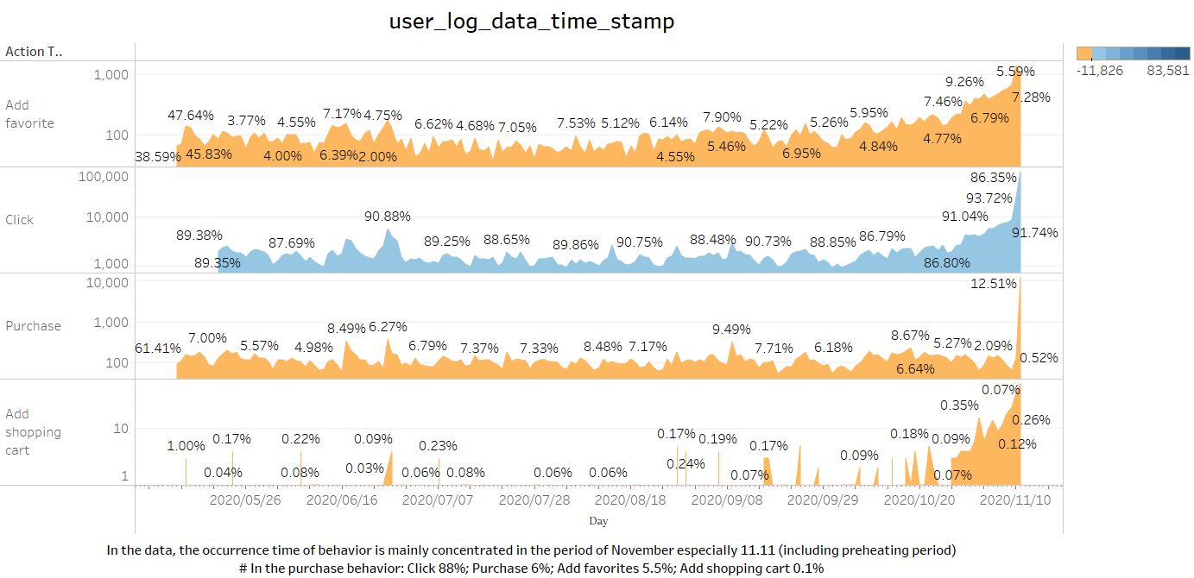

Slide 4
